Slide 1


BUILD AN AI CHATBOT FOR ELEVEN MADISON PARK IN COPILOT STUDIO

Slide 2








AI Agent 101
AI agents are systems, often powered by large language models (LLMs) like GPT-5 that can take goals you give them, decide how to achieve those goals, and then act using various tools, often without constant human guidance.
AI Agent
Trigger
Book a Flight from Toronto to NYC Next Week
LLM
© All rights reserved for Dr. Ryan Ahmed @Stemplicity Inc.
Instructions
Tools
Knowledge

Slide 3




Project Overview
In this project, we'll build an AI assistant that can answer questions about a specific topic (the Eleven Madison Park restaurant) based on provided documents in a database.
This technique is called Retrieval-Augmented Generation (RAG).
Input
Output
What kind of food does Eleven Madison Park Restaurant serve?
Eleven Madison Park serves a fully plant-based menu, using no animal products.
© All rights reserved for Dr. Ryan Ahmed @Stemplicity Inc.
Search
Fetch
Eleven Madison Park Data

Slide 4

Key Learning Outcomes
Build RAG-based AI agents for Eleven Madison Park restaurant in Copilot Studio.
Add External and Internal Knowledge to the AI Agent (websites, PDFs, word).
Add/customize Agent Triggers.
Publish and Test AI Agents in CoPilot Studio.
Understand the core principles of Retrieval-Augmented Generation (RAG).
© All rights reserved for Dr. Ryan Ahmed @Stemplicity Inc.

Slide 5
PRACTICE OPPORTUNITY

Slide 6

Practice Opportunity
Stemplicity employees frequently ask questions about expenses and vendor processes. Your task is to build an AI assistant in Copilot Studio that answers questions using ONLY the two provided documents:
  “Stemplicity – Travel & Expense Policy.docx”
  “Stemplicity – Procurement & Vendor Management Policy.docx”
Tasks:
1. Upload the documents to the Knowledge Base
2. Build the Agent
Name: Stemplicity Finance Assistant
Tone: Professional, concise, friendly
Rules: (1) Answer only using the uploaded documents, (2) Never guess or invent information, (3) Reference which policy the answer came from, (4) Decline politely when the information is not available
3. Test Your Agent
Questions the agent should answer (in documents):
What is the per diem for meals at Stemplicity?
“Are alcohol expenses reimbursable?”
“Who can approve a $4,000 purchase?”
Questions the agent should decline (not in documents)
© All rights reserved for Dr. Ryan Ahmed @Stemplicity Inc.

Slide 7
RETRIEVAL AUGMENTED GENERATION (RAG) 101

Slide 8


Retrieval Augmented Generation (RAG)
RAG is a technique that combines retrieval-based systems with generative AI models.
It's commonly used to enhance the capabilities of LLMs by integrating external knowledge sources.
R
A
G
Prompt
Retriever
Prompt + Context
Output
User
Fetch
LLM
Search
© All rights reserved for Dr. Ryan Ahmed @Stemplicity Inc.
Database (context)
R Lookup the external source to retrieve the relevant information
A Add the retrieved information to the user prompt
G Use LLM to generate a response to the user prompt with the context

Slide 9
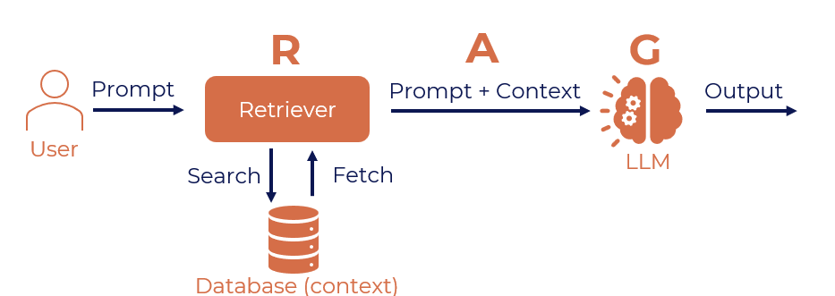
Retrieval Augmented Generation (RAG)
The user writes a prompt or a query that is passed to an orchestrator.
The orchestrator sends a search query to the retriever.
Retriever fetches the relevant information from the knowledge sources and sends back.
The orchestrator augments the prompt with the context and sends it to the LLM.
LLM responds with the generated text which is displayed to the user via the orchestrator.
© All rights reserved for Dr. Ryan Ahmed @Stemplicity Inc.

Slide 10
Why use RAG?
Accurate Responses: Combines retrieval with generative AI to ground outputs in factual data, minimizing errors.
Up-to-Date Information: Dynamically accesses the latest content, ensuring relevance without retraining.
Cost-Efficient:
Reduces computational burden by relying on retrieval for context, cutting costs.
Customizable:
Easily tailored to specific industries and domains with custom datasets.
Explainable:
Increases trust by surfacing the data sources behind generated responses.
© All rights reserved for Dr. Ryan Ahmed @Stemplicity Inc.

Slide 11
Fine-tuning Vs. RAG
Aspect | Fine-Tuning | Retrieval-Augmented Generation (RAG)
What It Is | Training the base model (e.g., GPT) on a specific dataset to adapt it to a particular use case. | Combines GPT's language generation with a retrieval mechanism that fetches external information.
How It Works | Provide a labeled dataset tailored to your task. | A document or database is indexed using a vector database.
 | Retrain the model using this data, updating its weights. | When queried, retrieves the most relevant chunks using similarity search.
 |  | GPT generates responses by combining retrieved information with general knowledge.
Use Case | Useful for well-structured, high-quality datasets and niche understanding. | Ideal for applications requiring up-to-date or domain-specific knowledge without retraining.
 | Requires compute resources and training expertise.
Advantages | Deeply integrates the knowledge from the dataset. | Does not require retraining the model; integrates external knowledge.
 |  | Easier to maintain; data can be updated without modifying the model.
 |  | Cost-effective compared to fine-tuning.
Drawbacks | Expensive and time-consuming. | Relies on the quality of the retrieval system and indexed data.
 | Locks the model into a specific knowledge set, limiting flexibility for dynamic or broad queries. | Retrieval may fail if documents are poorly indexed or irrelevant data is fetched.
© All rights reserved for Dr. Ryan Ahmed @Stemplicity Inc.

Slide 12

Summary
Retrieval-Augmented Generation (RAG) is a robust approach for combining retrieval systems with generative language models to deliver accurate, context-aware outputs.
An end-to-end RAG pipeline was developed in Copilot studio.
Covered how to add internal and external knowledge to the Agent.
Mastered how to add triggers & topics, publish and test AI agents in Copilot studio.
© All rights reserved for Dr. Ryan Ahmed @Stemplicity Inc.

Slide 13
Thank you!

